Slide 1

Sruthi Machina | Kevin Fu | Dhruvi Kothari | Ricardo Jénez
“Enable The Individual Investor To Make Better Long-Term Equity Decisions”
Notes:
Dhruvi
Investors want to beat the market in a consistent way.
StockPick is an automated and transparent ML driven platform that generates monthly stock picks, while providing respective probabilities of beating the market, explanations of our significant model features, and their prediction impact.
Armed with predictions that they trust and understand, investors will reap 1.5x the S&P 500 returns on average over 10 year rolling periods following our suggested strategy.

Slide 2
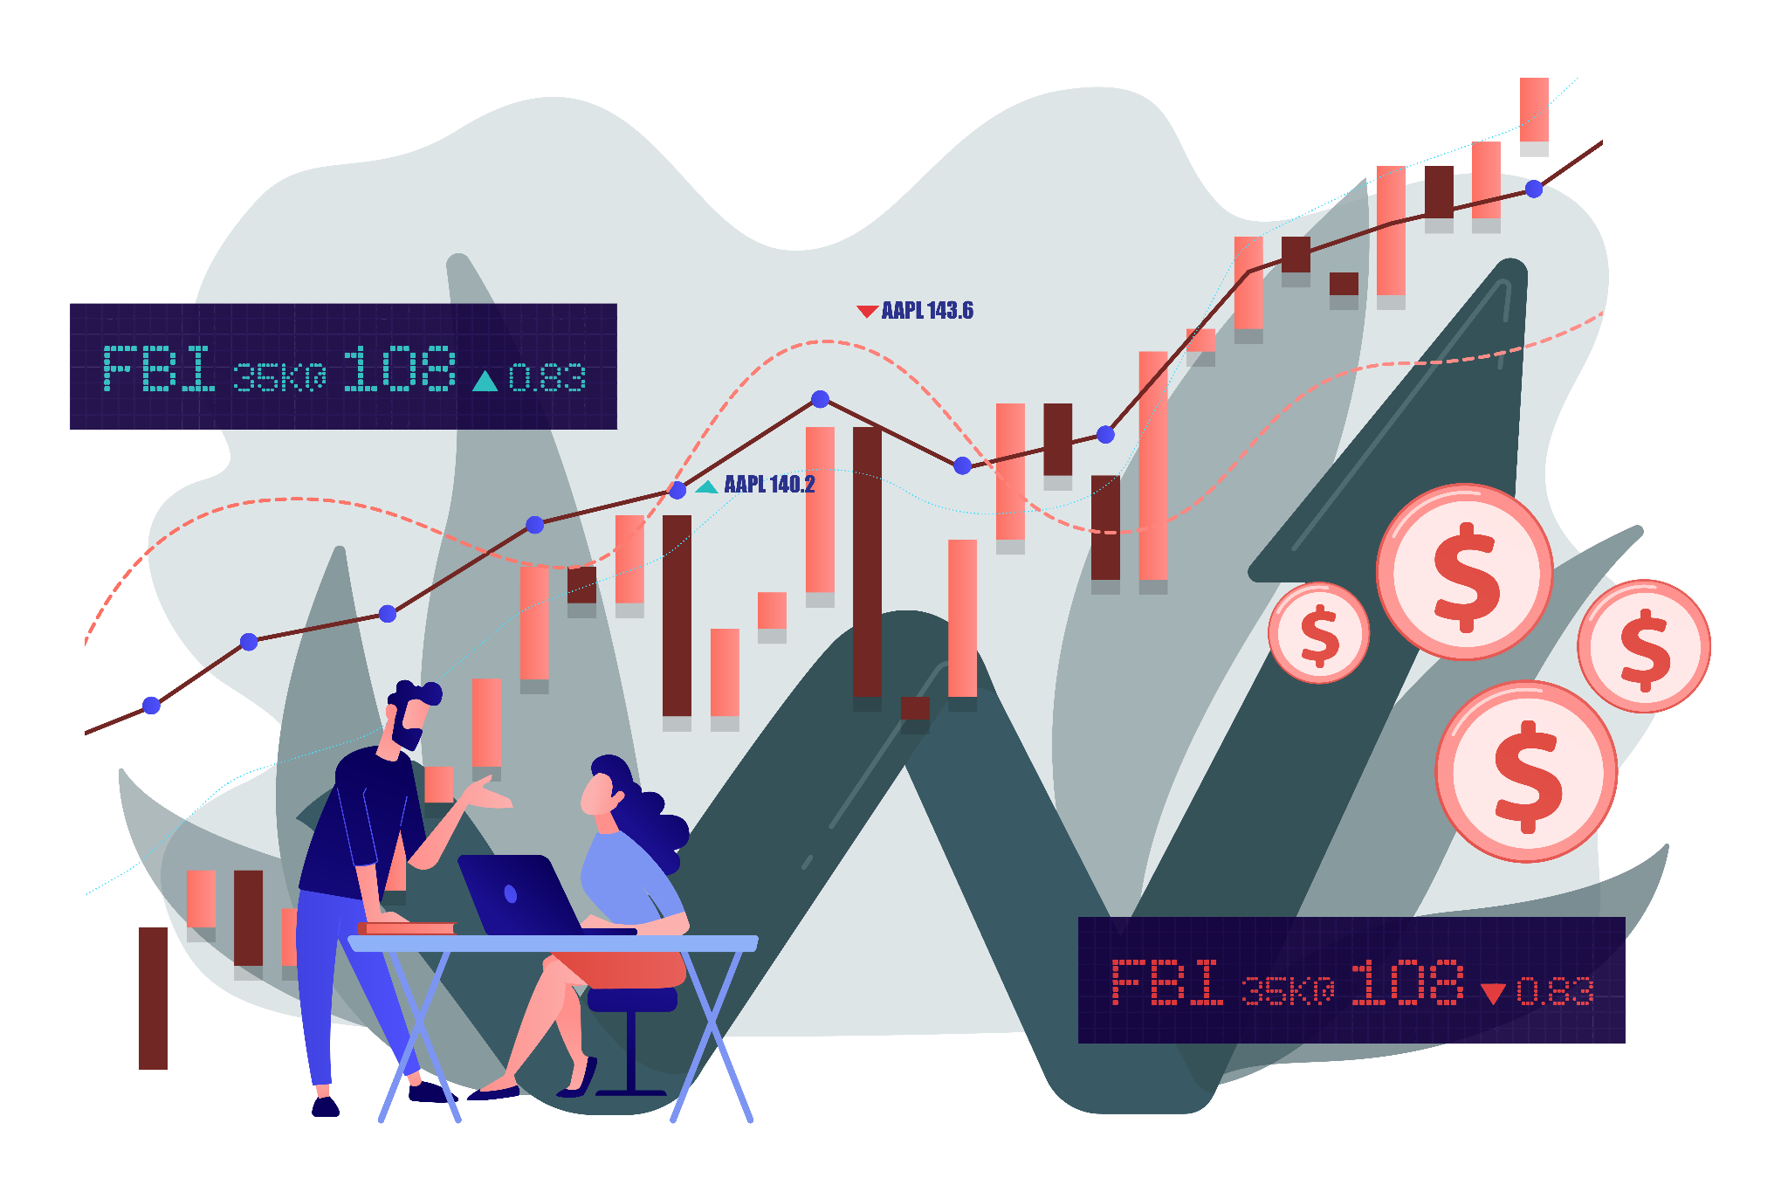

WHAT ARE WE DOING AT
Notes:
Dhruvi :
Investors want to beat the market in a consistent way.
StockPick is an automated and transparent ML driven platform that generates monthly stock picks, while providing respective probabilities of beating the market, explanations of our significant model features, and their prediction impact.
Armed with predictions that they trust and understand, investors will reap 1.5x the S&P 500 returns on average over 10 year rolling periods following our suggested strategy.

Slide 3

Problem
Problem 1 : Product Issues
Current AI/ Machine Learning efforts geared either towards trading (not long-term investments) or is not built for individual investors
Current Gap
A product that’s data-driven, automated, and transparent which assists individual investors in making sound and quick long-term investment strategies and gives insight as to what those decisions are based on.
Problem 2: Conceptual Profitability Issues
If there exists a service such as stock-rankings which help individual investors in making long-term decisions, they are not transparent or require a lot of prior market studying.
Notes:
Dhruvi
It’s a bi-fold 1) lack of accessible product for long-term investment and 2) a product geared towards maximizing ROI that is transparent. So to visually explain the problem:

Slide 4
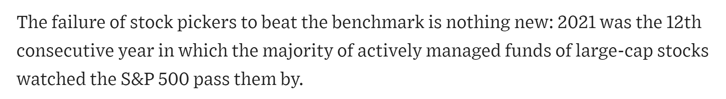
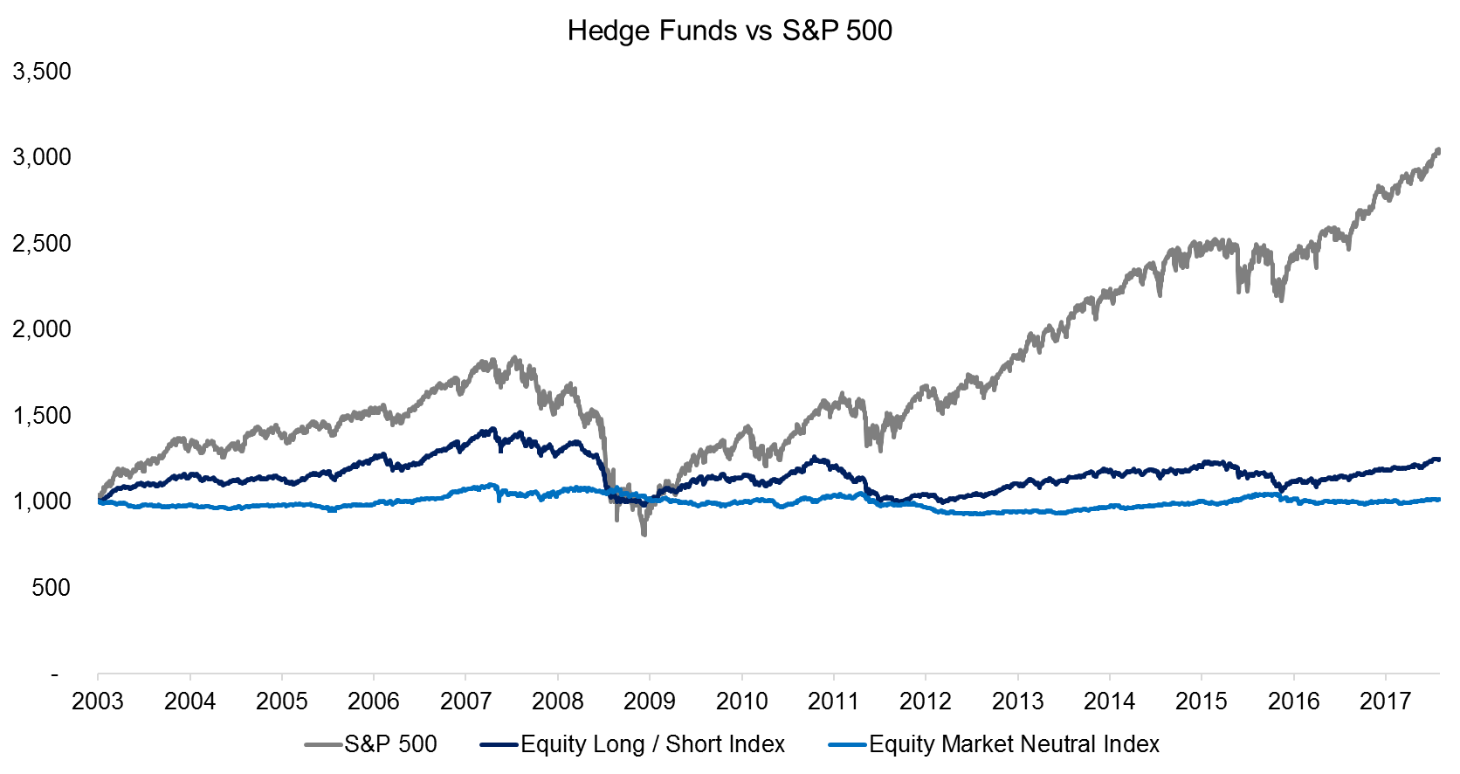
Hedge Funds continue to underperform the SPX by 50%+
-WSJ
Notes:
Dhruvi
To visually explain the problem of profitability which is the main concern, in the past 15 years hedgefund indexes have continues to underperform. Investors pay staggering sums annually to advisors, often incurring several layers of consequential costs. In the aggregate, do these investors get their money’s worth?
So basically there is a lack of data driven, automated, and transparent product to assist an investor in making sound and quick long-term investments to maximize their returns.
Source: https://insights.factorresearch.com/research-hedge-fund-factor-exposure-alternatives/
Source: https://www.wsj.com/articles/stock-pickers-watched-the-s-p-500-pass-them-by-again-in-2021-11647402018
Over the last 15 years.

Slide 5

Solution
Generate a list of five stocks that will outperform the S&P 500 over any one year period that individual investors can use to outperform the market and hedge funds.
One year expected stock appreciation and dividends representing total return for the stock as percent relative to invested capital.
These percent returns are then compared to similar annualized returns from a specific index, and then ranked against all other stocks.
Notes:
Sruthi
An advanced machine learnt algorithm to evaluate stock performance based on fundamental data, current market prices, and market sentiment, and compare against known indexes such as S&P500.
We will compute the probability of a given stock outperforming the S&P 500 in the next 1, 3, or 5 years

Slide 6
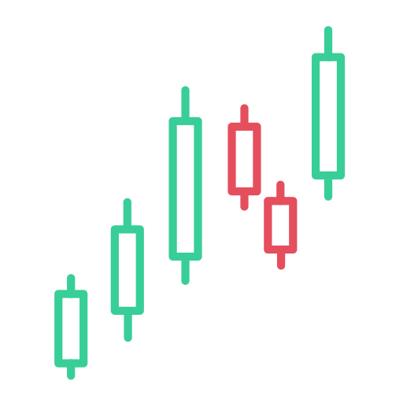

Competitive Market Insights
StockPickAI is working in a challenging market area – predicting long-term performance of stocks using fundamental and other market data – that has not been (publicly) addressed by many companies
-Trevor Anderson (Sequoia Capital)
-Joe Mirza, CFA (MIDS ‘22, HawksHead Capital)
Notes:
Sruthi
Pick quotes from our notes here:
https://docs.google.com/document/u/1/d/18hQb5yQuMG9_fPLILDDAaQpNI6B329z6TYuSLA5DWPQ/edit

Slide 7
Solution: Product Architecture
Inputs
Models
Outputs
Historical Prices of 7000+ Securities
Ranked Stocks
XGBoost
Fundamental Ratios
Financial Statements
(10-K, 10-Q, 8-K)
Feature Analysis
Notes:
Sruthi
Themes that can result from the predictions or from the sentiment analysis

Slide 8
Our Solution vs. Peers
*HFRX Global Hedge Fund Index, Returns over 20 years: 1998-2018: 4% per yr (vs. ~8% SPX)
https://bookshelf.corestone.ch/wp-content/uploads/2018/11/HF-and-PE-Factsheet.pdf **https://www.forbes.com/advisor/investing/how-to-invest-in-hedge-funds/, https://smartasset.com/financial-advisor/citadel-advisors-review#:~:text=Citadel%20Advisors%20Minimum%20Account%20Size,minimums%20at%20their%20discretion%2C%20though.
 | Us (StockPickAI) | Hedge Funds | Quant Funds
Outcome Variable | A Probability | Binary (Buy or Sell) | Binary (Buy or Sell)
Measurement of Success | Outperf SPX every year | Outperf SPX over 10 years | Outperf SPX over 10 years
Time period of prediction | 1 year | 10 years | Seconds/Minutes/Days
Main Indicators Used | Fundamental | Fundamental | Technical
Returns | ≥1.5x SPX returns over 10 yrs | 0.5x SPX returns over 10 yrs (HRFX Global HF Index)* | No measurable index equivalent
Transparent | Yes | No | No
Uses Machine Learning | Yes | No | Yes
Min Investment Req | $1200 | $100,000 - $2M** | $1-10M (Citadel)**
Notes:
Sruthi HFRX Global Hedge Fund Index, Returns over 20 years: 1998-2018: 4% per yr (vs. ~8% SPX)

Slide 9
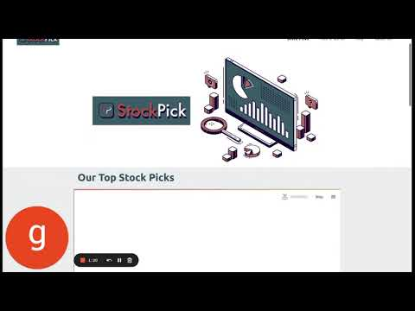
Notes:
Dhruvi
Demo should cover use-case and user guide.

Slide 10
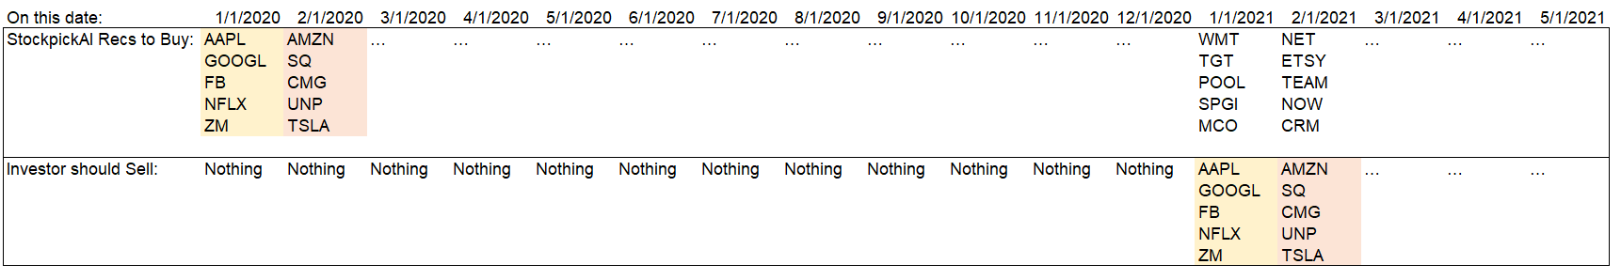
User Guide / Example for Illustration
3 Easy Steps:
StockPickAI picks 5 stocks to buy every month (60 stocks per year). Investors buy those 5 stocks every month
Investors sell each “class” of 5 stocks one year after initial purchase.
Investors reinvest proceeds from the previous 5 stocks into the 5 new recommendations.
Example for Illustration:
Notes:
Kevin
Thanks Dhruvi! So just to illustrate how all this is going to work, we have a simple example:
Lets imagine today is 1/1/2020. Our model picks 5 stocks: AAPL GOOGL etc. Since most of us are graduating here, let’s call those “The Class of Jan 2020”. An Investor will invest $100 in each of those 5 stocks.
Next month, its 2/1/2020. Our model again picks 5 stocks: AMZN SQ, etc, and that will be “The Class of Feb 2020”. Again the Investor invests $100 each of them as well.
Repeat this same process every month until Dec 2020.
It is now 1/1/2021. The Investor will now sell “The Class of Jan 2020”, which is the AAPL, GOOGL, etc. This time, the Investor will reinvest those proceeds into our model’s 5 new picks (WMT, Target).
Repeat this for Feb 2021 - Sell the 5 we picked on Feb 2020 (AMZN SQ), and reinvest into the new picks.
Repeat this process unemotionally for 20 years and you should see something like….
—---------------------------------------------------------------------------------------------
If a potential investor has $1200 to invest. Divided by 12 months, you have $100 total per month. Divided by our top 5 picks, its $20 to each stock.

Slide 11
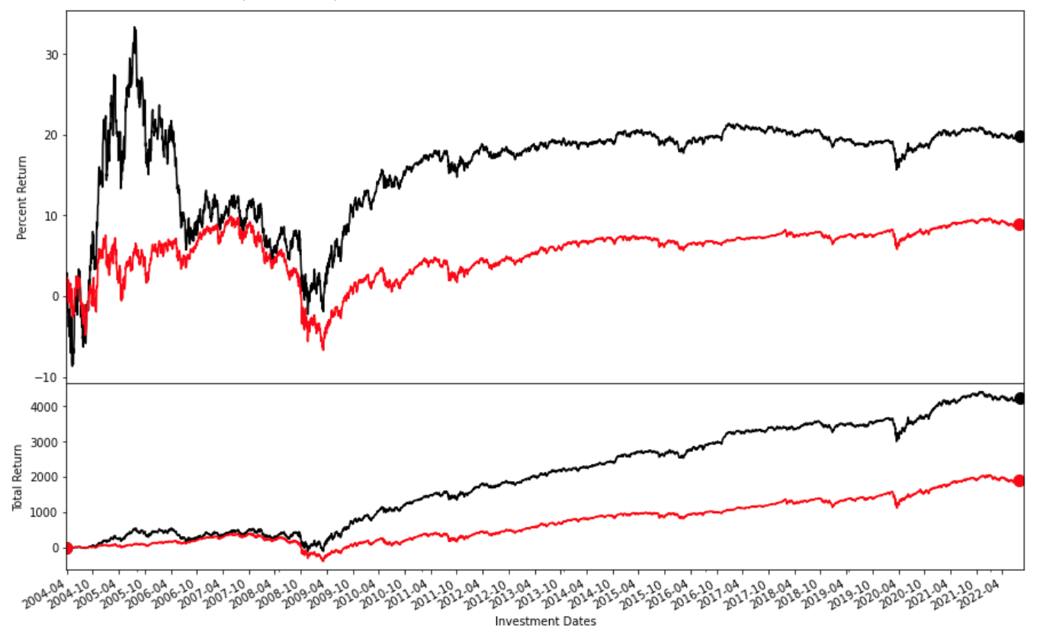
Results: ~20 Year Performance (2004 - 2022)
StockPickAI
Avg Return:
+19.9% per year
S&P 500 Avg Return:
+8.9% per year
Assumes no compounding.
Results also published on website
StockPickAI: +19.9%
S&P 500: +8.9%
StockPickAI:
+$4227
S&P 500:
+$1891
Notes:
Kevin
-Headline = StockpickAI generates roughly Double the S&Ps returns over 20 years. 20% annual returns (on avg) vs. 9% for the S&P.
-This Number is higher if you include compounding, but we excluded it to just make the math easier.
-Our Goal: Drastically Outperform the S&P during Up periods, Match/Tie S&P during Down periods.
-We want to emphasize that in order for this to work, we need to do this consistently over the long term. Eg. If you bought in 05 and sold in 08, your results are not so good, but if you did this over 20 years, your results are likely very good.
—------------------------------------------------------
1990-2002 train (rolling 10 yrs), 2002-2003 validation (1 yr), 2004- test set (1 month predicting on next year).
Rolling 10 Yr Train Period: 1/1/2010 - 1/1/2020, 1 Yr Validation Period: 1/1/2020 - 1/1/2021, 1 Month Test Period: 1/1/2021 - 2/1/2021, Predict top stocks for 3/1/2022
Model Avg Test Acc: 63.18% (where the model actually outperforms and beats the SPY)

Slide 12
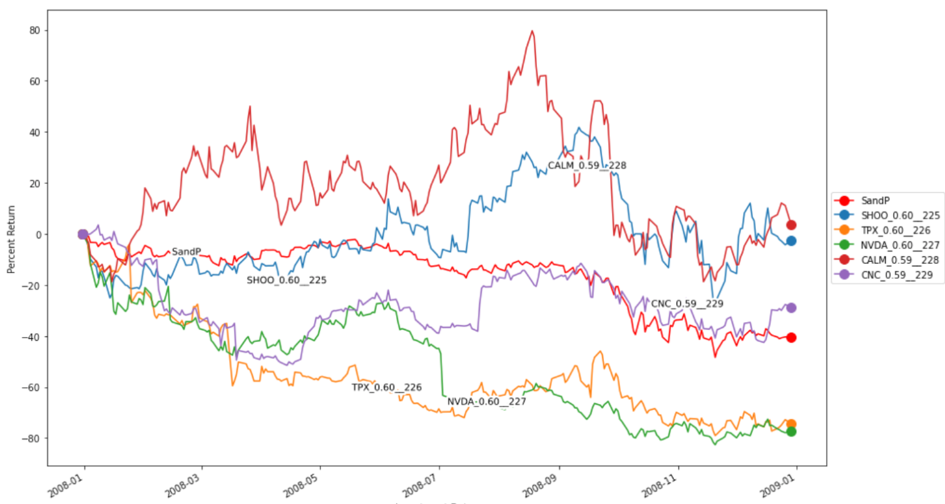
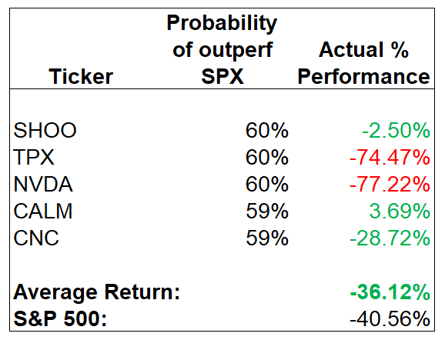
Results - Recession: 2008 Performance of Top 5 Picks
Notes:
Kevin
-Some of you are probably curious to see how we do during a recession
-On the bottom right side, you can see that 3 out of our 5 top picks outperform. We also have the actual model probabilities and % returns for those stocks.
-Even tho our goal is to tie the S&P, we do generate a modest 4% outperformance.
—-----------------------------------------------------------------------------------
Again, we are not specifically looking to protect on the downside - our product is not for you if you are looking to do that.
Aim to do slightly better/match the S&P’s performance in down months, and generate most of our alpha in up months (next slide).
(Time period: 2/1/08-2/1/09)

Slide 13
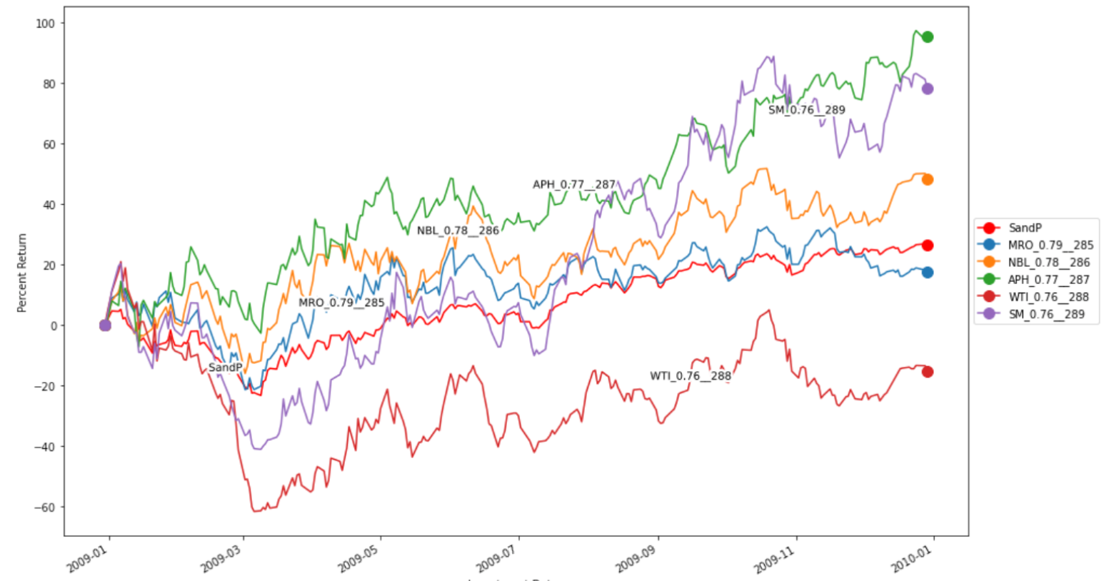
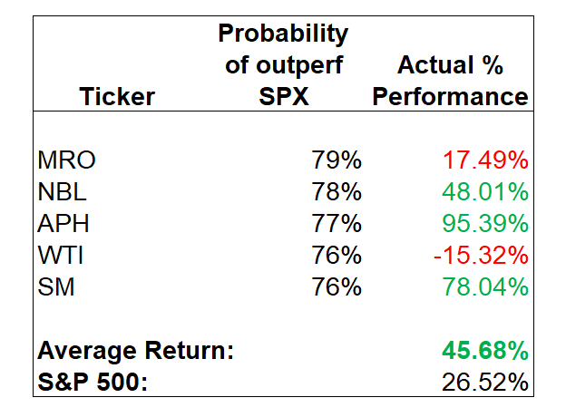
Results - Recovery: 2009 Performance of Top 5 Picks
Notes:
Kevin
-And here is the recovery out of the recession - a great example of us generating alpha in the up months.
-Again, 3 out of our 5 top picks outperform.
-Even though we didnt go 5 for 5, our winners drastically outperformed the losers, and we ended up with a much higher return (almost double) vs the S&P.
-And now Ricardo will go into which of the Features were the most Important in terms of generating our Top 5 monthly picks.
—---------------------------------------------------------
-Mid cap energy/natural gas/oil focus here: Marathon oil, Noble energy, Amphenol Corp, W&T Offshore, SM Energy

Slide 14
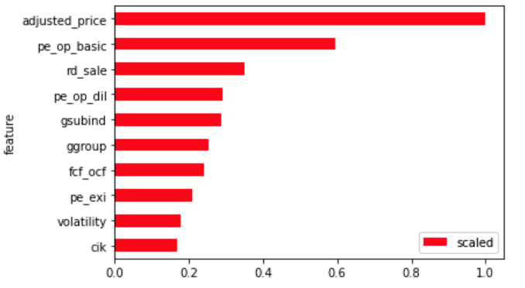
Results - Top 10 Features per SHapley Additive exPlanations*
~50 out of 130 features were significant
<1% difference in accuracy
3x higher run time
Top 10 Features are:
Historical Price (Momentum)
Price/Operating Earnings (pre-tax operating earnings)
R&D as a % of sales
GICS Sub-Industry
GICS Group
Free Cash Flow/Operating Cash Flow
Volatility of Stock
* SHAP -https://towardsdatascience.com/shap-explained-the-way-i-wish-someone-explained-it-to-me-ab81cc69ef30
Notes:
Ricardo
-SHapley Additive exPlanations, which answers: Which features contributed the most to predicting the outcome variable (outperformance)?
-50 features were insignificant. We removed them because for the ~1% increase in accuracy, our runtime increased by 3x. Maybe if we had a more powerful machine we would include but for now we will not.
- We can see that price momentum, volatility, operational earnings, free cash flow and Industry Sector GICS (The Global Industry Classification Standard (GICS®))were most important.
It really points to the fact that as we expected both market, and fundamental data are
important to predict long term performance over the one year window we have set for exceeding the S&P 500.

Slide 15
Results - Detailed
Data
Daily stock prices, monthly fundamental ratios, quarterly & annual financial data from 1990.
5400+ stocks with varied lifetime on US stock exchanges (market cap greater than $300MM)
~19.5M rows (daily dataset) -> ~700K rows (monthly dataset) -> ~225K rows remain for training over 10 years, ~2K test/evaluation size for each month period.
Model
XGBoost Classifier model using RandomSearchCV to identify top model with Shap Analysis
Identifies most important contributors to model performance over a 10 year period
Top features change over every 10 year period (business cycle is ~7-10 years)
Rolling 10 Yr Train Period, 1 Yr Validation Period, 1 Month Test Period to predict top stocks for next year
Predict top 5 stocks that are expected to outperform the S&P 500 over the next year from current date
Based on probability derived from model
Notes:
Ricardo
Approximately 5400 stocks with value of > $300MM,
~19.5 MM rows of price data and 700K of monthly data, over almost 20 year period. We trained wth about 225K of data for each 10 year period.
The monthly data joined price, fundamentals, for monthly, quarterly, annual data, as well as some sector designation
We used an XGBoost model to with RandomSearch to identify top model parameters and fed the results into a SHAP analysis (as we saw earlier) - With a rolling 10 year period from month to month to train the model and predicting on the performance of an out of sample month stocks that would exceed the S&P 500.
We picked the 5 stocks with highest probability to exceed the performance a year from the prediction.

Slide 16
Feedback
“Knowing the critical factors for each stock’s performance is essential for analysts and investors…StockPick’s model with explainability for each stock pick would be insightful for the experienced and novice stock picker.”
-Trevor Anderson (Sequoia Capital)
“Where StockPickAI differentiates itself is the ability to explain the choices offered to investors. With a proven track record of performance with their models, a solution like theirs would be a valuable asset for retail, institutional, or fund investors.”
-Joe Mirza, CFA (MIDS ‘22, HawksHead Capital)
Notes:
Ricardo
Notes: https://docs.google.com/document/u/1/d/18hQb5yQuMG9_fPLILDDAaQpNI6B329z6TYuSLA5DWPQ/edit
We had feedback from Trevor Anderson who heads Global Equities at Sequoia Capital and Joe Mirza, on of our classmates a former Hedge Fund Manger.
Both zeroed in on the utility of providing stock pickles with explainability of the models stock picks being extremely important, both for novice and experienced
Investors. However, to entire this challenging market, having a proven track record is vital and that is what we will do as we incorporate the company.

Slide 17
Conclusion
Product-market fit (ready for market)? √
Something people want to use? √
Productively addresses a specific need? √
Transparent and explainable? √
Net positive towards helping investors (ESG)? √
Equal access for all √
No redlining √
Clear pathway to profitability? √
Notes:
Kevin
-Thanks Ricardo! So in conclusion, we think have something that has solid product-market fit, something people want to use, and addresses a specific need.
Stockpickai clearly addresses the investors’ overall Desire to outperform the market.
-In terms of ESG, we also have something that is Transparent and Explainable so that investors arent just throwing money into a black box.
Our model clearly explains what variables are causing which stocks to outperform.
In addition, our product is truly for all – unlike hedge funds, no gates, no minimum account size, no redlining - Everyone actually gets an Equal opportunity to participate.
-Thank you all for your time and attention today – we hope you all invest with us! (go to nxt slide)
—------------------------------------------------------------
Next Steps:
-Sharpe ratio
-Exact numerical figures that correspond to what each feature’s change means for actual financial statement movement
-Vertical Expansion Opportunity: Fundamentals/Financial Statement Prediction

Slide 18

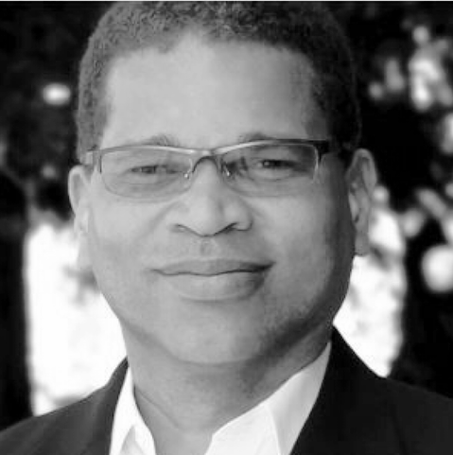



Thank You!
Sruthi Machina
Associate Data Scientist
Ricardo Jenez
Startup Advisor
stockpickai.com
Dhruvi Kothari
Data Scientist
Kevin Fu
Senior Associate

